Slide 1
M O D U L E - 5

Slide 2
C O N T E N T S
MAINTENANCE
Overview of maintenance process
Types of maintenance
RISK MANAGEMENT
Software risks
Risk identification
Risk monitoring and management
PROJECT MANAGEMENT CONCEPT
People
Product
Process
Project

Slide 3
M A I N T E N A N C E

Slide 4
INTRODUCTION
It is a task that is likely to happen when the software is delivered to the customer site, & it is installed and operational
Delivery or release of a software inaugurates the maintenance phase of life cycle
Consumes 40%-70% of cost of entire life cycle
It may span for 20 years

Slide 5
INTRODUCTION
Software Maintenance is a very broad activity that includes
Error corrections
Enhancements of capabilities
Deletion of obsolete capabilities
Optimization
Any work done to change the software after it is in operation is considered as maintenance work
The purpose is to preserve the value of the software over time

Slide 6
CATEGORIES OF MAINTENANCE
Corrective maintenance
Adaptive maintenance
Perfective maintenance

Slide 7
CORRECTIVE MAINTENANCE
This refer to modifications initiated due to defects appearing in the software, while it is in use
Defects arises due to
Design errors
Logic errors
Coding errors

Slide 8
CORRECTIVE MAINTENANCE
Design errors occur when changes made to the software are
Incorrect
Incomplete
Wrongly communicated
Logic errors occur due to
Invalid tests & conclusions
Incorrect implementation of design specification
Faulty logic flow
Incomplete test data
Coding errors arises due to
Incorrect implementation of detailed design
Incorrect use of source code logic
Data processing errors
System performance errors

Slide 9
Patching
If a system failure occurs, actions are taken to restore the operation
Maintenance personnel sometimes perform emergency fixes called as patching
This method leads to many problems
Increase program complexity
Unforeseen ripple effects
change to one part of a program may affect other sections in an unpredictable manner
This leads to distortion in the logic of the system

Slide 10
ADAPTIVE MAINTENANCE
It includes modifying the software to adapt to the changes in the environment.
Environment refers to the external influences acting on a software
Eg:
Business rules
Govt policies
Work patterns
Software & hardware platforms
A change to the environment require modifications to the software
Modifications happens when software moves to a different hardware or software platform

Slide 11
PERFECTIVE MAINTENANCE
This maintenance happens for improving
Processing efficiency
Performance
Changeability of the software
User tries to expand the requirements & enhance existing system functionality
This maintenance is also called Enhancement
Enhancements are done to
Make the product better
Faster
Better documented
structured

Slide 12
Other types of maintenance
Maintenance increase in the complexity of the software,
The work is required to be done to reduce it, if possible.
This work may be named as preventive maintenance.

Slide 13
PREVENTIVE MAINTENANCE.
Aim of this maintenance is to make the program understandable
Activities include
Code restructuring
Code optimization
Documentation updating
This reduces the complexity of the code

Slide 14
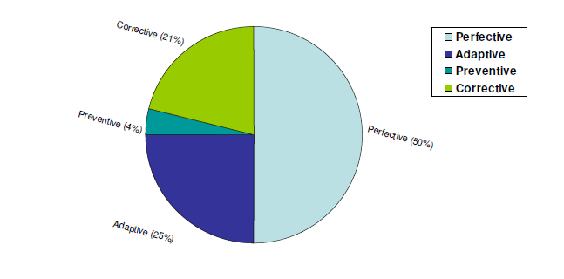

Slide 15
Problems during maintenance
Often the program is written by one person & maintenance done by another person
Often the program is changed by person who did not understand it clearly.
Program listings are not structured.
High staff turnover.

Slide 16
Solutions
Budget and effort reallocation
Time & resources are to be invested for the development of maintainable systems rather than un-maintainable systems
Complete replacement of the system
If maintenance cost of existing system is greater than cost of developing a new one, it is better to develop new one from scratch
Maintenance of existing system
Complete replacement of a system is not a viable option
Current s/m must have the potential to evolve to the higher state
Existing s/m must integrate to other ones in a cost effective manner

Slide 17
R I S K M A N A G E M E N T

Slide 18
INTRODUCTION
Every project is susceptible to risks
Without effective risk management, even the planned projects become failure
Project manager should anticipate & identify different risks susceptible to the project
He should prepare contingency plans before hand to contain the risk
Risk management
It aims to reduce the chances of risk becoming real
Also reduces the impact of a risk that becomes real

Slide 19
ACTIVITIES OF RISK MANAGEMENT
3 activities
Risk Identification
Risk Assessment
Risk Mitigation

Slide 20
RISK IDENTIFICATION
Project manager needs to anticipate the risks in the project as early as possible
After identifying the risks, risk management plans are made
Risk identification is similar to listing down the nightmares by the manager
Eg: vendors not completing their work on time
Poor quality work
Manpower turnover

Slide 21
RISK IDENTIFICATION [2]
To identify the risks systematically, we have to categorize risks into different classes
Project manager examines the risks in each classes
Identify the risks that are relevant to the project
Categories of risks are
Project risks
Technical risks
Business risks

Slide 22
RISK IDENTIFICATION [3]
Project risks
This include problems related to
Budgetary
Schedule
Personnel
Resource
Customer related issues
Important project risk is schedule slippage
This arises since the software projects are difficult to monitor
Due to its invisibility it is very difficult to asses the progress

Slide 23
RISK IDENTIFICATION [4]
Technical risks
It includes problems related to
Potential design
Implementation
Interfacing
Testing
Maintenance
Technical risks also includes
Incomplete specification
Changing specification
Technical uncertainty
Most of the technical risks arises due to insufficient knowledge about the product

Slide 24
RISK IDENTIFICATION [5]
Business risks
This includes
Risk of building a product that no one wants
Losing budgetary commitments
To successfully identify risks, it is good to have a company disaster list
Company disaster list
Contains all the bad events that have happened to the s/w projects of the company over the years
This list can be read by the project manager to be aware of susceptible risks to the project

Slide 25
R I S K A S S E S S M E N T
Objective of risk assessment is to rank the risks in terms of their damage causing potential
Each risk is rated in 2 ways
The probability of risk becoming real (r)
The consequence of problems associated with that risk(s)
Based on these two factors priority of each risk is calculated
P=r*s
P➔ priority with which the risk should be handled
r➔ probability of the risk becoming real
s➔ severity of damage caused if the risk becomes real
If all the risks are prioritized, then the most likely and damaging risks are handled first

Slide 26
R I S K M I T I G A T I O N
After identifying all risks, plans are made to control the most damaging and likely risks first
Different risks have different containment/control procedures
Strategies for risk containment
Avoid the risk
Transfer the risk
Risk reduction

Slide 27
R I S K M I T I G A T I O N
Avoid the risk
Risks can be avoided in several ways
Risks often arises due to project constraints
So risks can be avoided by modifying the constraints
Categories of constraints which give rise to risks
Process related constraints
Product related constraints
Technology related constraints

Slide 28
R I S K M I T I G A T I O N
Process related constraints
Risks arises due to following constraints
Aggressive work schedule
Budget
Resource utilization
Product related constraints
Risks arises due to
Commitment to challenging product features
Quality
Reliability
Technology related constraints
Risks arises due to
Use of certain technology

Slide 29
R I S K M I T I G A T I O N
Risks can be avoided by
Discussing with customer to change the requirements
Giving incentives to the developers to avoid the risk of manpower turnover

Slide 30
R I S K M I T I G A T I O N
Transfer the risks
This involves getting the risky components developed by a third party
Or buying insurance cover etc
Risk reduction
This involves planning different things to contain the damage due to a risk
Eg: if there is a risk of manpower turnover, new recruitment can be planned
Technical risks can be reduced by building a prototype of the technology that you are going to use

Slide 31
R I S K M O N I T O R I N G & M A N A G E M E N T

Slide 32
RISK MONITORING
As the project proceeds, risk-monitoring activities commence.
The project manager monitors factors that may provide an indication of the risk
Risk monitoring is a project tracking activity
Objectives
Assess whether predicted risks occur or not
Ensure that risk aversion steps defined for the risk are being properly applied
Collect information that can be used for future risk analysis.

Slide 33
EXAMPLE: HIGH STAFF TURNOVER
The factors monitored for the above risk
The general attitude of team members based on project pressures
Interpersonal relationships among team members
Potential problems with compensation and benefits
Availability of jobs within the company and outside it are all monitored

Slide 34
Other factors monitored
Project manager should monitor the effectiveness of risk mitigation steps.
Suppose that the risk mitigation step taken to resolve manpower turnover is proper documentation
Manager has to monitor the following
Check whether work products or documents are developed in a timely manner.
This is to ensure continuity
Newcomer gets necessary information from these documents, if he is forced to join the software team in the middle of the project

Slide 35
RISK MANAGEMENT
Risk management is done if the risk mitigation efforts are failed & risk has become a reality
In such a case, if we have followed mitigation strategy, then
Backup will be available
Information will be documented
knowledge has been dispersed across the team.
Newcomers must be added to the team to “get up to speed.”
Those individuals who are leaving are asked to stop all work and spend their last weeks in “knowledge transfer mode.”
This might include
video-based knowledge capture,
the development of commentary documents
meeting with other team members who will remain on the project.

Slide 36
RMMM plan
A risk management strategy can be included in the software project plan,
The risk management steps can be organized into
Risk Mitigation Monitoring Management plan.
The RMMM plan documents all work performed as part of risk analysis
It is used by the project manager as part of the overall project plan.

Slide 37
RISK INFORMATION SHEET
Some software teams do not develop a formal RMMM document.
Each risk is documented individually using a Risk Information Sheet (RIS)
RIS is maintained using a database system
Creation and information entry
Priority ordering
Searches
Other analysis may be accomplished easily

Slide 38
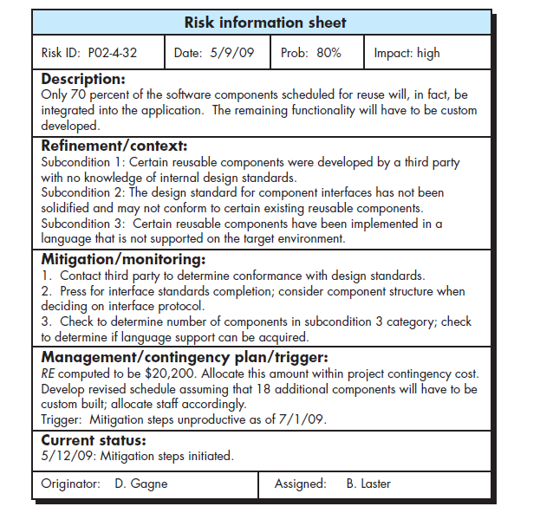
RISK INFORMATION SHEET

Slide 39
P R O J E C T M A N A G E M E N T

Slide 40
INTRODUCTION
Effective software project management focuses on the four Ps:
People
Product
Process
Project

Slide 41
P E O P L E
The “people factor” is so important
Software Engineering Institute has developed a People Capability Maturity Model (People-CMM),
This is because, every organization needs to continually improve its ability to
Attract
Develop
Motivate
Organize
Retain
the workforce needed to accomplish its strategic business objectives

Slide 42
PEOPLE- CMM
It defines following
Staffing
Communication and coordination
Work environment
Performance management
Training
Compensation
Competency analysis and development
Career development
Workgroup development
Team/ culture development
Organizations that achieve high levels of People-CMM have a higher likelihood of implementing effective software project management practices.

Slide 43
P R O D U C T
Before a project can be planned,
Product objectives must be established
Scope should be established
Alternative solutions should be considered
Technical and management constraints should be identified.
Without this information, we cannot define
Estimates of the cost
Effective assessment of risk
Breakdown of project tasks
Manageable project schedule

Slide 44
P R O D U C T
Stakeholders must meet to define product objectives and scope.
Product Objectives
Identify the overall goals for the product from the stakeholder’s points of view
Does not consider how these goals will be achieved.
Scope identifies the
Primary data
Functions
Attempts to bound these characteristics in a quantitative manner.

Slide 45
Once the product objectives and scope are understood, alternative solutions are considered.
alternatives enable managers to select a “best” approach

Slide 46
PROJECT
We conduct planned and controlled software projects to manage complexity
Although the success rate for present-day software projects may have improved, project failure rate remains to be higher

Slide 47
METHODS TO AVOID PROJECT FAILURE
Project manager and the software engineer must
Avoid a set of common warning signs
Understand the critical success factors
Develop a commonsense approach for
Planning
Monitoring
controlling the project.

Slide 48
THE PEOPLE
People build computer software
Projects succeed because well-trained, and motivated people get things done.
But often they are taken for granted by the managers & other senior engineers

Slide 49
STAKEHOLDERS
They are categorized into 5
Senior managers
Define the business issues that often have a significant influence on the project.
Project managers
Who plan, motivate, organize, and control the practitioners who do software work.
Practitioners
Deliver the technical skills that are necessary to engineer a product or application.
Customers
Specify the requirements for the software to be engineered
End users
Interact with the software once it is released for production use.

Slide 50
TEAM LEADERS
Every software project is populated by people who fall within this taxonomy.
To be effective, the project team must be organized in a way that maximizes each person’s skills and abilities.
And that’s the job of the team leader.

Slide 51
FEATURES FOR A GOOD TEAM LEADER
MOI model of leadership states the following features
Motivation.
The ability to encourage technical people to produce to their best ability.
Organization.
The ability to mold existing processes or invent new ones
Ideas or innovation.
The ability to encourage people to
create and feel creative even when they work within bounds of a particular software product

Slide 52
This model suggests that, successful project leaders apply a problem-solving management style.
Software project manager should concentrate on
Understanding the problem to be solved
Manage the flow of ideas
Lets everyone on the team know that quality will not be compromised.

Slide 53
KEY FEATURES OF EFFECTIVE PROJECT MANAGER
Problem solving
Managerial identity
Achievement
Influence & team building

Slide 54
PROBLEM SOLVING
An effective software project manager can
Diagnose the technical and organizational issues
Can systematically structure a solution
Motivate other practitioners to develop the solution,
Apply lessons learned from past projects to new situations
Remain flexible enough to change direction if initial attempts at problem solution are fruitless.

Slide 55
MANAGERIAL IDENTITY
A good project manager must take charge of the project.
She/he must have the confidence to assume control when necessary
allow good technical people to follow their instincts.

Slide 56
ACHIEVEMENT
A competent manager must
Reward initiative to optimize the productivity of a project team.
Demonstrate through her own actions that controlled risk taking will not be punished.

Slide 57
INFLUENCE & TEAM BUILDING
An effective project manager must be able to
“Read” people
Understand verbal and nonverbal signals
React to the needs of the people sending these signals.
Manager must remain under control in high-stress situations.

Slide 58
THE SOFTWARE TEAM
The “best” team structure depends on
the management style of your organization,
the number of people who will populate the team and their skill levels,
overall problem difficulty.
Factors that affect the structure of teams
difficulty of the problem to be solved;
“size” of the resultant program
time that the team will stay together
degree to which the problem can be modularized;
quality and reliability of the system to be built;
rigidity of the delivery date,
degree of sociability (communication) required for the project.

Slide 59
ORGANIZATIONAL PARADIGM FOR SOFTWARE ENGINEERING TEAM
Closed paradigm
Random paradigm
Open paradigm
Synchronous paradigm

Slide 60
CLOSED PARADIGM
Structures a team along a traditional hierarchy of authority.
Such teams can work well while producing software similar to past efforts,
but they will be less innovative when working within the closed paradigm.
Also called as chief programmer team

Slide 61
RANDOM PARADIGM
structures a team loosely
depends on individual initiative of the team members.
they excel when innovation or technological breakthrough is required,
But such teams may struggle when “orderly performance” is required.
Also called as innovative anarchy

Slide 62
OPEN PARADIGM
Structure a team in a manner that
achieves some of the controls associated with the closed paradigm
but also much of the innovation that occurs when using the random paradigm.
Work is performed collaboratively, with heavy communication and consensus-based decision
These are well suited to the solution of complex problems
but may not perform as efficiently as other teams

Slide 63
SYNCHRONOUS PARADIGM
Relies on the natural compartmentalization of a problem
Organizes team members to work on pieces of the problem
No active communication among themselves.

Slide 64
High performance team
Team members must have trust in one another,
distribution of skills must be appropriate to the problem,
mavericks may have to be excluded from the team, if team cohesiveness is to be maintained.

Slide 65
Jelled team
A jelled team is a group of people so strongly knit that the whole is greater than the sum of the parts
Once a team begins to jell, the probability of success goes way up.
The team can become unstoppable, a juggernaut for success
They don’t need to be managed in the traditional way
they certainly don’t need to be motivated.
They’ve got momentum.

Slide 66
Factors leading to team toxicity
Frenzied work atmosphere,
High frustration that causes friction among team members,
Fragmented or poorly coordinated” software process,
Unclear definition of roles on the software team,
Continuous and repeated exposure to failure.”

Slide 67
Solutions
To avoid a frenzied work environment,
the team must have access to all information required to do the job
major goals and objectives, once defined, should not be modified unless absolutely necessary
A software team can avoid frustration
if it is given responsibility for decision making

Slide 68
An inappropriate process can be avoided by
understanding the product to be built,
the people doing the work,
by allowing the team to select the process model.
Failure can be avoided by
establishing team-based techniques for feedback and problem solving.

Slide 69
Agile team
The small, highly motivated project team,
Adopts many of the characteristics of successful software project
avoids many of the toxins that create problems.
It focus on individual competency , & group collaboration

Slide 70
Agile teams are self-organizing.
A self-organizing team does not necessarily maintain a single team structure
instead, uses elements of random, open, and synchronous paradigms

Slide 71
Features
Planning is kept to a minimum, and the team is allowed to select its own approach
team self-organizes to focus individual competency which is beneficial to the project
conduct daily team meetings to coordinate and synchronize the work that must be accomplished for that day.

Slide 72
Coordination & communication issues
The scale of many development efforts is large,
This lead to
complexity,
confusion,
Difficulties in coordinating team members.
Uncertainty is common
This result in a stream of changes that ratchets the project team.
Interoperability has become a key characteristic of many systems.
New software must communicate with existing software and conform to predefined constraints imposed by the system or product.

Slide 73
Solution
Establish effective methods for coordinating the people who do the work.
Formal & informal communication methods
Formal communication is accomplished through
Writing
structured meetings,
Informal communication is more personal.
Members of a team share ideas on an ad hoc basis,
ask for help as problems arise,
interact with one another on a daily basis.

Slide 74
THE PRODUCT

Slide 75
Introduction
A software project manager always faces a dilemma at the very beginning of a software project.
Quantitative estimates and an organized plan are required, but solid information is unavailable.
A detailed analysis of software requirements would provide information necessary for estimates
Problems
analysis often takes weeks or even months to complete.
requirements may be fluid,
It may changing regularly as the project proceeds.

Slide 76
2 main activities of project management
Establish scope
Establish product objectives

Slide 77
Software scope
Scope is defined by answering the following questions:
Context.
What is the business context,? and what constraints are imposed as a result of the context?
Information objectives.
What data objects are produced as output from the software?
What data objects are required for input?
Function and performance.
What function does the software perform to transform input data into output?
Are any special performance characteristics to be addressed?

Slide 78
Features of scope
scope must be unambiguous and understandable at the management and technical levels.
A statement of software scope must be bounded.
quantitative data are stated explicitly,
constraints and/or limitations are noted,
mitigating factors are described.

Slide 79
Problem decomposition
Also called partitioning or problem elaboration.
During the scoping activity no attempt is made to fully decompose the problem.
decomposition is applied in two major areas:
the functionality and content (information) that must be delivered and
the process that will be used to deliver it.

Slide 80
Complex problem is partitioned into smaller problems
Software functions, described in the statement of scope, are evaluated and refined.
This provide more detail prior to the beginning of estimation
Major content or data objects are decomposed into their constituent parts,
This provides a reasonable understanding of the information to be produced

Slide 81
THE PROCESS
Selection of an appropriate process model is very important
Process model selection must be based on
Customers who have requested the product
Project environment
Characteristics of the product
team then defines a preliminary project plan based on the set of process framework activities.
Once the preliminary plan is established, process decomposition begins.

Slide 82
Melding the product & process
Project planning begins with the melding of the product and the process.
Each function to be done by the team must pass through the set of framework activities

Slide 83
Example
Consider the following framework activities
communication,
planning,
modeling,
construction,
deployment
The team members who work on a product function will apply each of the framework activities to it

Slide 84
A matrix is created
Left side➔ functions of word processing s/w
Framework activities are listed in top
Job of the project manager is to
estimate resource requirement for each matrix cell
Start & end dates tasks associated with each cell,
work products to be produced as a consequence of each task.

Slide 85
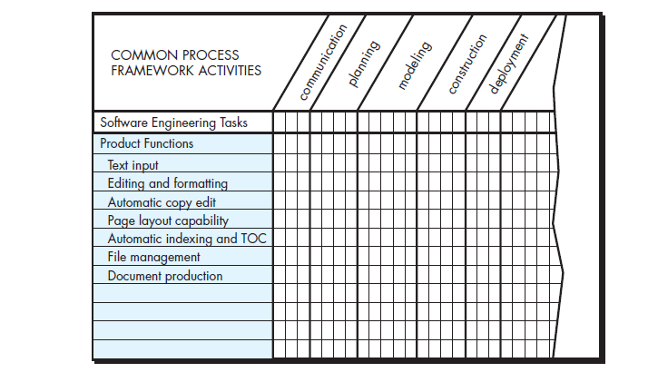

Slide 86
Process decomposition
Once the process model has been chosen, the process framework is adapted to it.
Process decomposition commences when the project manager asks following question
“How do we accomplish this framework activity?”
An activity is done using a series of work tasks

Slide 87
Example: communication activity
Series of work tasks are
Review the customer request.
Plan and schedule a formal meeting with all stakeholders.
Conduct research to specify the proposed solution and existing approaches.
Prepare a “working document” and an agenda for the formal meeting.

Slide 88
Conduct the meeting.
Jointly develop mini-specs that reflect data, function, and behavioral features of the software.
Review each mini-spec for correctness, consistency, and lack of ambiguity.
Assemble the mini-specs into a scoping document.
Review the scoping document
Modify the scoping document

Slide 89
The project
In order to manage a successful software project, you have to understand
what can go wrong so that problems can be avoided.
General problems
Poor understandability of customer requirements
Poorly defined scope
Technology changes & business shifts
Unrealistic deadlines

Slide 90
5 part commonsense approach of projects
Start on the right foot
Maintain momentum
Track progress
Make smart decisions
Conduct a postmortem analysis

Slide 91
Start on the right foot
work hard to understand the problem that is to be solved
set realistic objectives and expectations for everyone involved in the project.
build the right team
Give the team the autonomy, authority, and technology needed to do the job.

Slide 92
Maintain momentum
To maintain momentum, the project manager must provide incentives to keep turnover of personnel minimum
The team should emphasize quality in every task it performs,
senior management should do everything possible to stay out of the team’s way.

Slide 93
Track progress
progress is tracked as work products are produced and approved
software process and project measures can be collected and used to assess progress

Slide 94
Make smart decisions
decisions of the project manager must be simple
use existing software components or patterns,
avoid custom interfaces when standard approaches are available,
identify and then avoid obvious risks,
allocate more time than you think is needed to complex or risky tasks

Slide 95
Conduct postmortem analysis
Establish a consistent mechanism for extracting lessons learned for each project.
Evaluate the planned and actual schedules,
collect and analyze software project metrics
get feedback from team members and customers,
record findings in written form

Slide 96
W⁵HHH principle
This principle is used to define the key project characteristics
Why is the system being developed?
What will be done?
When will it be done?
Who is responsible for a function?
Where are they located organizationally?
How will the job be done technically and managerially?
How much of each resource is needed?

